Slide 1
Video game database
Sam Gamez
Jared Darnell
Steven Lamoreaux

Slide 2
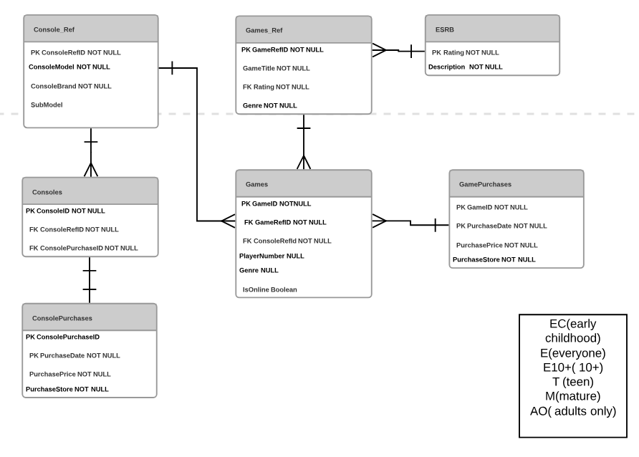
Table design

Slide 3
Why we chose our table design

Slide 4
Obstacles in group work

